Slide 1
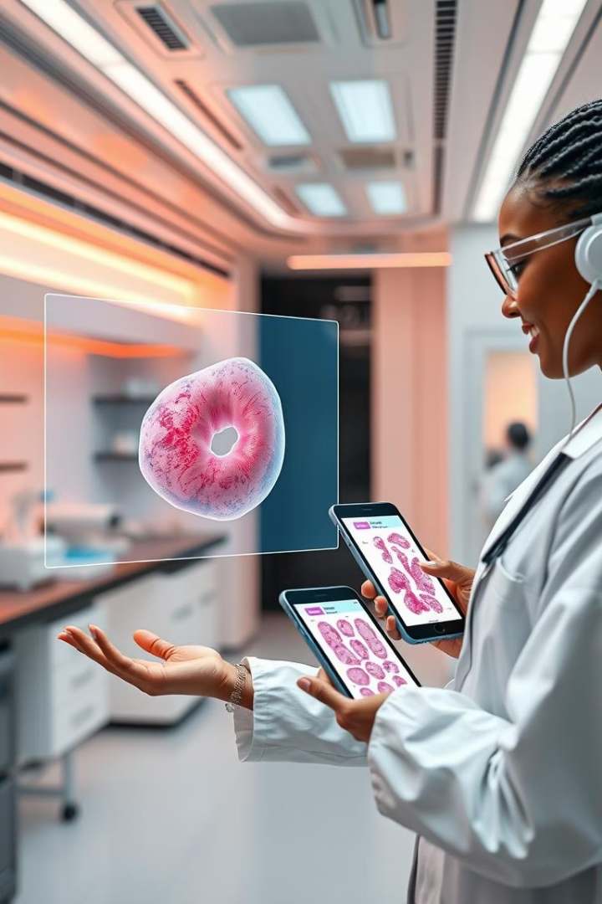

DeepMammoAI: Revolutionizing Breast Cancer Diagnosis
Machine Learning for Early Detection
17th April, 2025
by Y.O. Ibrahim

Slide 2
Challenges in Breast Cancer Diagnosis
Manual Analysis
Computational Complexity
Accessibility
Error-prone, time-consuming (30+ features)
Full-feature models are demanding
Limited real-time tools in poor settings

Slide 3








How DeepMammoAI Works
Dataset
Feature Selection
WDBC (569 samples, 357 benign, 212 malignant)
Top 10 clinically significant features
Streamlit App
Neural Network
Interactive interface for real-time predictions
98% accuracy (2 hidden layers, ReLU)

Slide 4
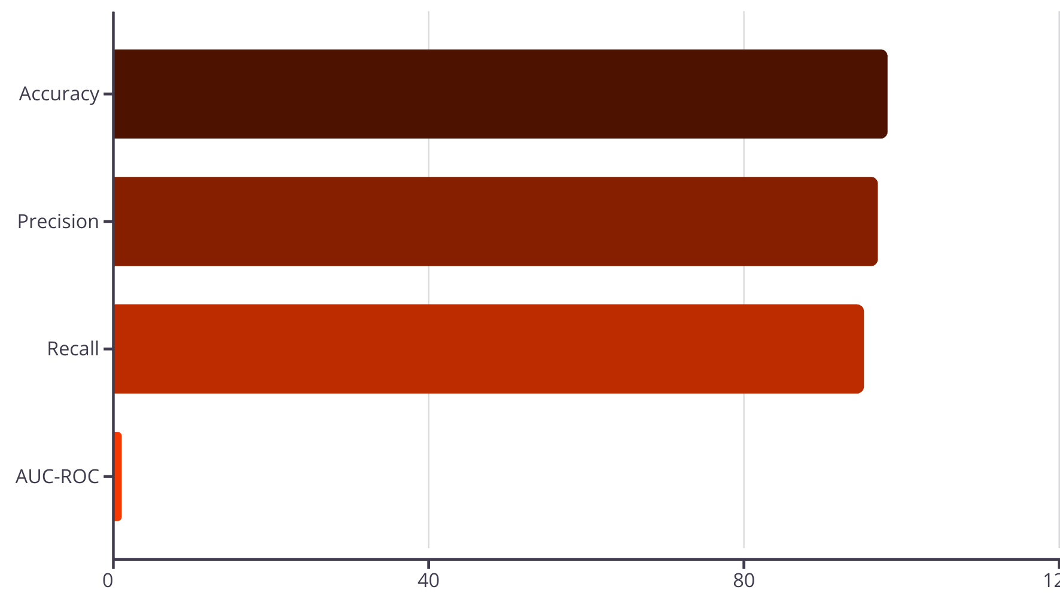
Performance Metrics
98.2%
97.1%
95.3%
0.98
10 features retain 98% of original performance

Slide 5
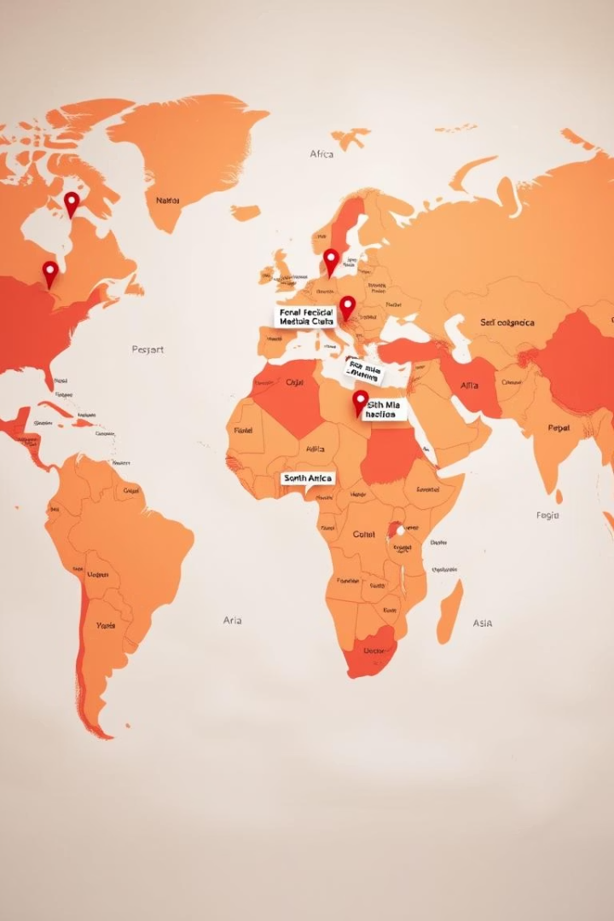



Real-World Impact
Clinical Use
Rapid diagnosis for pathologists
Accessibility
Lowers barriers in resource-limited settings
Research
Benchmark for feature selection in medical ML

Slide 6
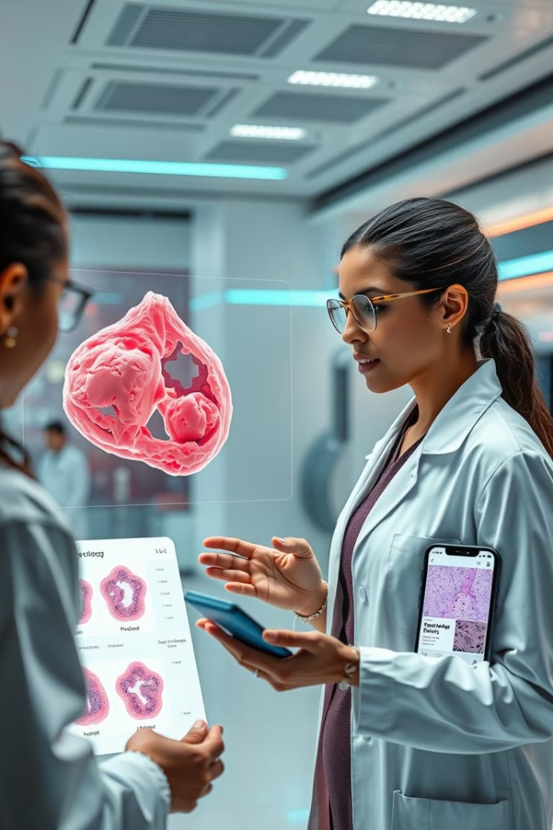



Expanding Horizons
Histopathology Images
Integrate BreakHis dataset
Mobile App
Point-of-care use
Multi-Class
Tumor subtype classification

Slide 7






Join the Fight Against Breast Cancer
Researchers
Refine with larger datasets
Hospitals
Collaborate for validation
Developers
Enhance app functionality
Bridging AI Innovation and Clinical Care

Slide 8





Our Team
Ibrahim Yusuf O.
Ahmad Nura
Abduljalal Kutama
Ruqayya Yunusa Y.
Data Scientist (Team Lead)
Frontend Developer
Graphic Designer
Data Analyst
Rodiyah A. Kareem
Graphic Designer

Slide 9
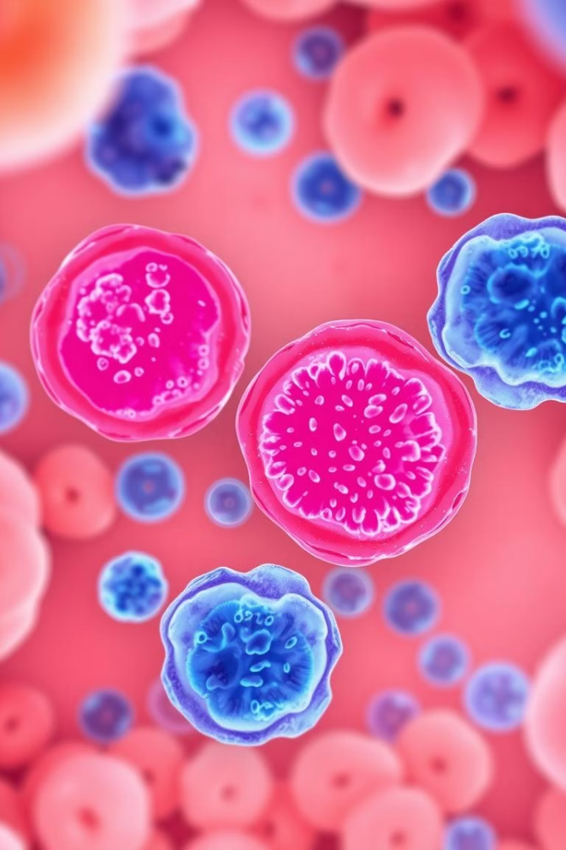
Key Takeaways
DeepMammoAI
Clinical Validation
Revolutionizing Breast Cancer Diagnosis
Needs real-world implementation
AI Innovation
Bridging the gap to improve healthcare

Slide 10

Thank You
We appreciate your time and consideration.

